Slide 1
BITS Pilani presentation
Dr S. S. Chauhan
sansar@wilp.bits-pilani.ac.in

Slide 2
Data Structures and Algorithms Design
Lecture No. 2

Slide 3
Contents
Use of asymptotic notation,
Big-Oh,
Omega
Theta.
Little-Oh, and
Little-Omega Notation
Analyzing Recursive Algorithms:
Recurrence relations,
Specifying runtime of recursive algorithms,
Solving recurrence equations.
Master Theorem.
Case Study: Analysing Algorithms

Slide 4
Last Session Revision …….
Algorithms and it’s Specification,
Random Access Machine Model,
Counting Primitive Operations,
Notion of best case, average case and worst case.

Slide 5
Algorithms and it’s Specification
An algorithm is a step-by-step procedure for performing some task in a finite amount of time.
Data structure is a systematic way of organizing and accessing data.
These concepts are central to computing, but to be able to classify some algorithms and data structures as "good:' we must have precise ways of analyzing them.

Slide 6
Characteristics of an algorithm:-
· Must take an input.
· Must give some output(yes/no, value etc.)
· Definiteness –each instruction is clear and unambiguous.
· Finiteness –algorithm terminates after a finite number of steps.
· Effectiveness –every instruction must be basic i.e. simple instruction.

Slide 7
Expectation from an algorithm
Correctness:-
Correct: Algorithms must produce correct result. Approximation algorithm: Exact solution is not found, but near optimal solution can be found out. (Applied to optimization problem.)
Less resource usage:
Algorithms should use less resources (time and space).

Slide 8
To analyse an algorithm
Code and execute, find actual time.
What does the total time depend upon
Algorithm
Number of inputs
Count the number of primitive operations like assignment, function call, control transfer, arithmetic etc.
Solution to all issues is : Asymptotic analysis of algorithms.

Slide 9
The Random Access Machine (RAM) Model
A CPU
Potentially unbounded bank of memory cells, each of which can hold an arbitrary number or character
2
1
0
Memory cells are numbered and accessing any cell in memory takes unit time.

Slide 10
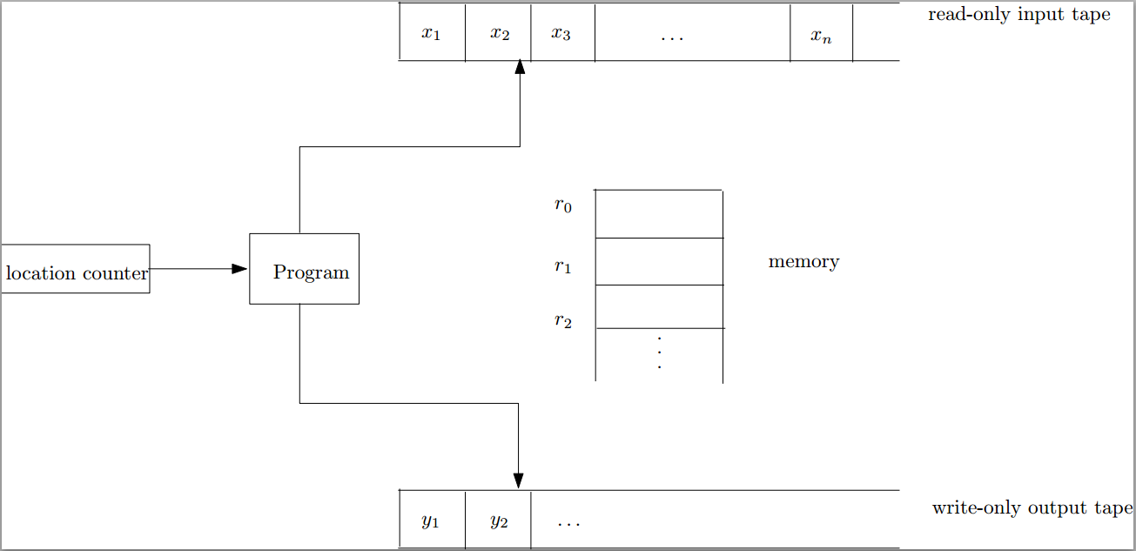
Random Access Model (RAM)
Time complexity (running time) = number of instructions executed
Space complexity = the number of memory cells accessed

Slide 11
Our Machine Model
Generic Random Access Machine (RAM)
Executes operations sequentially
Set of primitive operations:
Arithmetic. Logical, Comparisons, Function calls
Simplifying assumption: all ops cost 1 unit
Eliminates dependence on the speed of our computer, otherwise impossible to verify and to compare

Slide 12
Primitive Operations
Basic computations performed by an algorithm
Identifiable in pseudocode
Largely independent from the programming language
Exact definition not important (we will see why later)
Examples:
Evaluating an expression
Assigning a value to a variable
Indexing into an array
Calling a method
Returning from a method

Slide 13
Analyzing pseudo-code (by counting)
For each line of pseudo-code, count the number of primitive operations in it.
Pay attention to the word "primitive" here; sorting an array is not a primitive operation.
Multiply this count with the number of times this line is executed.
Sum up over all lines.

Slide 14
Proving Loop Invariants
Proving loop invariants works like induction
Initialization (base case):
It is true prior to the first iteration of the loop
Maintenance (inductive step):
If it is true before an iteration of the loop, it remains true before the next iteration
Termination:
When the loop terminates, the invariant gives us a useful property that helps show that the algorithm is correct
Stop the induction when the loop terminates

Slide 15
Analysis of Insertion Sort
INSERTION-SORT(A)
for j ← 2 to n
do key ← A[ j ]
Insert A[ j ] into the sorted sequence A[1 . . j -1]
i ← j - 1
while i > 0 and A[i] > key
do A[i + 1] ← A[i]
i ← i – 1
A[i + 1] ← key
cost times
c₁ n
c₂ n-1
0 n-1
c₄ n-1
c₅
c₆
c₇
c₈ n-1
t_{j}: # of times the while statement is executed at iteration j
Notes:
₇

Slide 16
Best Case Analysis
The array is already sorted
A[i] ≤ key upon the first time the while loop test is run (when i = j -1)
t_{j} = 1
T(n) = c₁n + c₂(n -1) + c₄(n -1) + c₅(n -1) + c₈(n-1) = (c₁ + c₂ + c₄ + c₅ + c₈)n + (c₂ + c₄ + c₅ + c₈)
= an + b = Θ(n)
“while i > 0 and A[i] > key”

Slide 17
Worst Case Analysis
The array is in reverse sorted order
Always A[i] > key in while loop test
Have to compare key with all elements to the left of the j-th position ⇒ compare with j-1 elements ⇒ t_{j} = j
a quadratic function of n
T(n) = Θ(n²) order of growth in n²
“while i > 0 and A[i] > key”
using
we have:

Slide 18
Comparisons and Exchanges in Insertion Sort
cost times
c₁ n
c₂ n-1
0 n-1
c₄ n-1
c₅
c₆
c₇
c₈ n-1
INSERTION-SORT(A)
for j ← 2 to n
do key ← A[ j ]
Insert A[ j ] into the sorted sequence A[1 . . j -1]
i ← j - 1
while i > 0 and A[i] > key
do A[i + 1] ← A[i]
i ← i – 1
A[i + 1] ← key
≈ n²/2 comparisons
≈ n²/2 exchanges

Slide 19
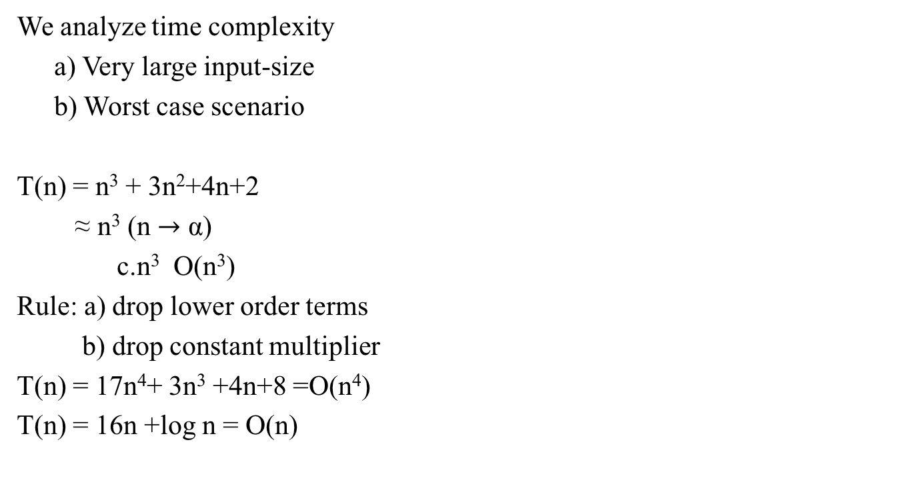
Time complexity analysis-some general rules.

Slide 20
Asymptotic Notation
Big-Oh
Omega
Theta
Little-Oh, and
Little-Omega Notation

Slide 21
Symbol Meaning
∃ (there exists): ∃ x: P(x) means there is at least one x such that P(x) is true
∀ (for all; for any; for each): ∀ x: P(x) or (x) P(x) means P(x) is true for all x
⊃: superset
⊂: subset

Slide 22
Asymptotic Complexity
Running time of an algorithm as a function of input size n for large n.
Expressed using only the highest-order term in the expression for the exact running time.
Instead of exact running time, say Θ(n²).
Describes behavior of function in the limit.
Written using Asymptotic Notation.

Slide 23
Asymptotic Notation
Θ, O, Ω, o, ω
Defined for functions over the natural numbers.
Ex: f(n) = Θ(n²).
Describes how f(n) grows in comparison to n.
Define a set of functions; in practice used to compare two function sizes.
The notations describe different rate-of-growth relations between the defining function and the defined set of functions.

Slide 24
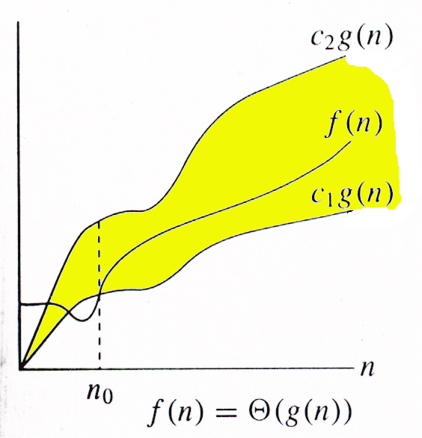
Θ-notation
For function f(n), we define Θ(g(n)), big-Theta of n, as the set:
Θ(g(n)) = {f(n) : ∃ positive constants c₁, c₂, and n_{0,} such that ∀n ≥ n₀,
we have 0 ≤ c₁g(n) ≤ f(n) ≤ c₂g(n)
}
Intuitively: Set of all functions that
have the same rate of growth as g(n).
g(n) is an asymptotically tight bound for f(n).

Slide 25
Example
Θ(g(n)) = {f(n) : ∃ positive constants c₁, c₂, and n₀, such that ∀n ≥ n₀, 0 ≤ c₁g(n) ≤ f(n) ≤ c₂g(n)}
n² /2 - 2n = Θ(n²)
What constants for n₀, c₁, and c₂ will work?
Make c₁ a little smaller than the leading coefficient, and c₂ a little bigger.
To compare orders of growth, look at the leading term.
Exercise: Prove that 2n²= Θ(n²)

Slide 26
n² /2 - 2n = Θ(n²)
C1=1/4, C2=1/2 and n0=8
2n²= Θ(n²)
C1=1, C2=3 (or C1=C2=2) and n0=0

Slide 27
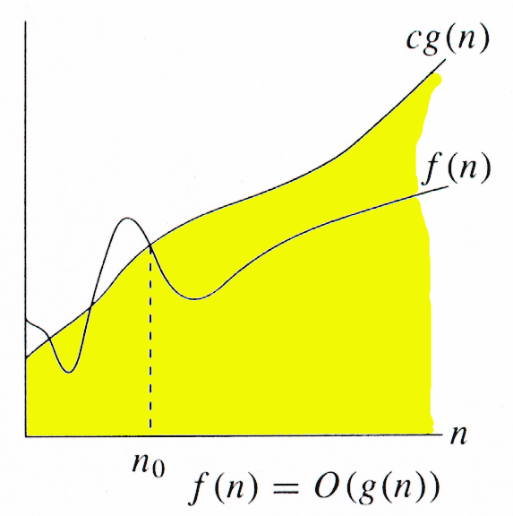
O-notation
For function f(n), we define O(g(n)), big-O of n, as the set:
O(g(n)) = {f(n) : ∃ positive constants c and n_{0,} such that ∀n ≥ n₀,
we have 0 ≤ f(n) ≤ cg(n) }
Intuitively: Set of all functions whose rate of growth is the same as or lower than that of g(n).
g(n) is an asymptotic upper bound for f(n).
f(n) = Θ(g(n)) ⇒ f(n) = O(g(n)).
Θ(g(n)) ⊂ O(g(n)).

Slide 28
Given functions f(n) and g(n), we say that f(n) is O(g(n)) if there are positive constants c and n₀ such that
f(n) ≤ cg(n) for n ≥ n₀
Example: 2n + 10 is O(n)
2n + 10 ≤ cn
(c − 2) n ≥ 10
n ≥ 10/(c − 2)
Pick c = 3 and n₀ = 10

Slide 29
More Big-Oh Examples
7n-2
7n-2 is O(n)
need c > 0 and n₀ ≥ 1 such that 7n-2 ≤ c•n for n ≥ n₀
this is true for c = 7 and n₀ = 1
3n³ + 20n² + 5
3n³ + 20n² + 5 is O(n³)
need c > 0 and n₀ ≥ 1 such that 3n³ + 20n² + 5 ≤ c•n³ for n ≥ n₀
this is true for c = 4 and n₀ = 21
3 log n + 5
3 log n + 5 is O(log n)
need c > 0 and n₀ ≥ 1 such that 3 log n + 5 ≤ c•log n for n ≥ n₀
this is true for c = 8 and n₀ = 2

Slide 30
Big-Oh Rules (shortcuts)
If f(n) is a polynomial of degree d, then f(n) is O(n^{d}), i.e.,
Drop lower-order terms
Drop constant factors
Use the smallest possible class of functions
Say “2n is O(n)” instead of “2n is O(n²)”
Use the simplest expression of the class
Say “3n + 5 is O(n)” instead of “3n + 5 is O(3n)”

Slide 31
Examples
O(g(n)) = {f(n) : ∃ positive constants c and n₀, such that ∀n ≥ n₀, we have 0 ≤ f(n) ≤ cg(n) }
2n² =O(n³ )
2n² = O(n² )

Slide 32
2n² =O(n³ )
C=1 and n0=2
2n² = O(n² )
C=2 and n0=0

Slide 33
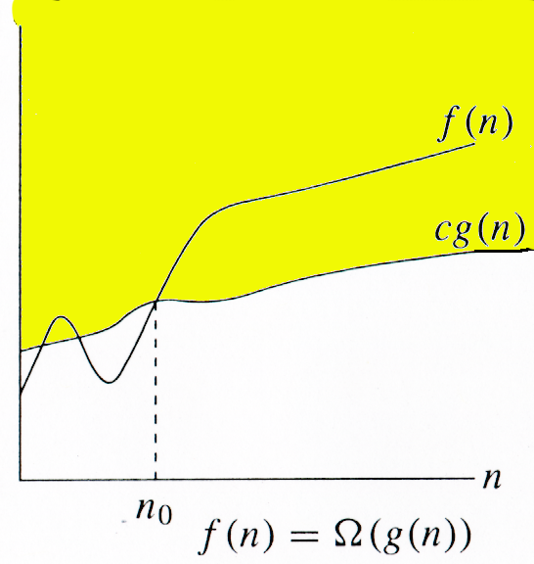
Ω -notation
For function f(n), we define Ω(g(n)), big-Omega of n, as the set:
Ω(g(n)) = {f(n) : ∃ positive constants c and n_{0,} such that ∀n ≥ n₀,
we have 0 ≤ cg(n) ≤ f(n)}
Intuitively: Set of all functions whose rate of growth is the same as or higher than that of g(n).
g(n) is an asymptotic lower bound for f(n).
f(n) = Θ(g(n)) ⇒ f(n) = Ω(g(n)).
Θ(g(n)) ⊂ Ω(g(n)).

Slide 34
Example
Ω(g(n)) = {f(n) : ∃ positive constants c and n₀, such that ∀n ≥ n₀, we have 0 ≤ cg(n) ≤ f(n)}
√n = Ω(lg n). Choose c and n₀.
C=1 and n0=16

Slide 35
o-notation
For a given function f(n), the set little-o:
o(g(n)) = {f(n): ∀ c > 0, ∃ n₀ > 0 such that ∀ n ≥ n₀, we have 0 ≤ f(n) < cg(n)}.
f(n) becomes insignificant relative to g(n) as n approaches infinity:
lim [f(n) / g(n)] = 0 {a/∞ = 0}
^{n→∞}
g(n) is an upper bound for f(n) that is not asymptotically tight.
Observe the difference in this definition from previous ones. Why?

Slide 36
Ex:
2n=o(n²)
but
2n²≠o(n²)

Slide 37
ω -notation
For a given function f(n), the set little-omega:
ω(g(n)) = {f(n): ∀ c > 0, ∃ n₀ > 0 such that ∀ n ≥ n₀, we have 0 ≤ cg(n) < f(n)}.
f(n) becomes arbitrarily large relative to g(n) as n approaches infinity:
lim [f(n) / g(n)] = ∞. {∞/a =∞}
^{n→∞}
g(n) is a lower bound for f(n) that is not asymptotically tight.

Slide 38
Ex:
n²/2=ω(n)
but
n²/2≠ ω(n²)

Slide 39
Recursive Algorithms & Recurrence relations
Analyzing Recursive Algorithms:
Recurrence relations,
Specifying runtime of recursive algorithms,
Solving recurrence equations.
Master Theorem.
Case Study: Analyzing Algorithms

Slide 40
Analysing Recursive Algorithms
Iteration is not the only interesting way of solving a problem. Another useful technique, which is employed by many algorithms, is to. use recursion.
In this technique, we define a procedure P that is allowed to make calls to itself as a subroutine, provided those calls to p are for solving sub problems, of smaller size.
The subroutine calls to P on smaller instances are called "recursive calls?'
A recursive procedure should always define a base. case, which is small enough that the algorithm can solve it directly without using recursion

Slide 41
Analyzing the running time of a recursive algorithm takes a bit of additional work, however*
In particular, to analyze such a running time, we use a recurrence equation, which defines mathematical statements that the running time of a recursive algorithm must satisfy.
We introduce a function T(n) that denotes the running time of the algorithm, on an input of size n, and we write equations that T(n) must satisfy
For example,
1 if n=1
T(n) =
T(n-1) + 1 if n>1

Slide 42
Recurrences
When an algorithm contains a recursive call to itself, its running time can often be described by a recurrence.
A recurrence is a function defined in terms of:
One or more base case, and
Itself with smaller arguments
Ex
Solution: T(n)=O(n)
1 if n=1
T(n) =
T(n-1) + 1 if n>1

Slide 43
1 if n=1
Solution: T(n)=O(nlgn)
T(n) =
2T(n/2) + n if n>1
1 if n=1
Solution: T(n)=O(nlgn)
T(n) =
T(n/3) + T(2n/3)+n if n>1

Slide 44
Solving recurrence equations.
The Iterative Substitution Method
The Recursion Tree
The Guess-and-Test Method
The Master Method

Slide 45
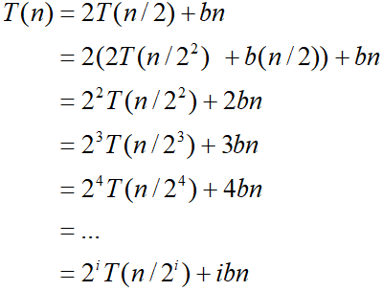
Iterative Substitution
In the iterative substitution, or “plug-and-chug,” technique, we iteratively apply the recurrence equation to itself and see if we can find a pattern:
Note that base, T(n)=b, case occurs when 2^{i}=n. That is, i = log n.
So,
Thus, T(n) is O(n log n).

Slide 46


Solving T(n) = 3T(n-2) with iterative method
T(n)=3T(n−2)
My first step was to iteratively substitute terms to arrive at a general form:
T(n−2)=3T(n−2−2)
=3T(n−4)
T(n)=3∗3T(n−4)
Leading to the general form:
T(n)=3^{k} T(n-2k)
n−2k=1 for k, which is the point where the recurrence stops (where T(1)) and
Insert that value (n/2−1/2=k) into the general form:
T(n)=3^{n/2-1/2}

Slide 47
Recursion Tree Method to Solve Recurrence Relations
Recursion Tree is another method for solving the recurrence relations.
A recursion tree is a tree where each node represents the cost of a certain recursive sub-problem.
We sum up the values in each node to get the cost of the entire algorithm.

Slide 48
Steps in Recursion Tree Method to Solve Recurrence Relations
Step-01:
Draw a recursion tree based on the given recurrence relation.
Step-02:
Determine-
Cost of each level
Total number of levels in the recursion tree
Number of nodes in the last level
Cost of the last level
Step-03:
Add cost of all the levels of the recursion tree and simplify the expression so obtained in terms of asymptotic notation.

Slide 49
The Recursion Tree
Draw the recursion tree for the recurrence relation and look for a pattern:
depth | T’s | size
0 | 1 | n
1 | 2 | n/2
i | 2^{i} | n/2^{i}
… | … | …
time
bn
bn
bn
…
Total time = bn + bn log n
(last level plus all previous levels)

Slide 50
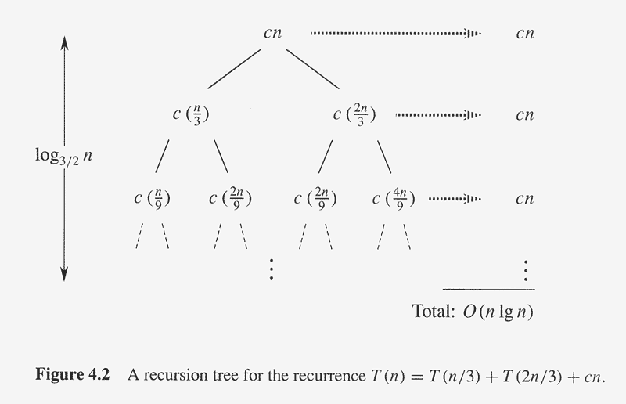
Recursion-Tree Method
T(n) =
T(n/3) + T(2n/3) + O(n)

